Slide 1
A Better Movie Selection Experience
Group 4 - Project 1

Slide 2



About the Team
Vandolph Baptiste
Juliet Goldstein
Krystal Duran

Slide 3
Value Added Proposal
Project Goal
Develop a responsive web application, with a mobile-first UI, that the would allow users to search through the content of their movie streaming applications to help them find the right movie or show to watch according to the following selection criteria:
Movie streaming applications (Netflix, Amazon, Hulu)
Genre
Movie vs show series
Assigned movie rating (G, PG, PG-13, R)

Slide 4
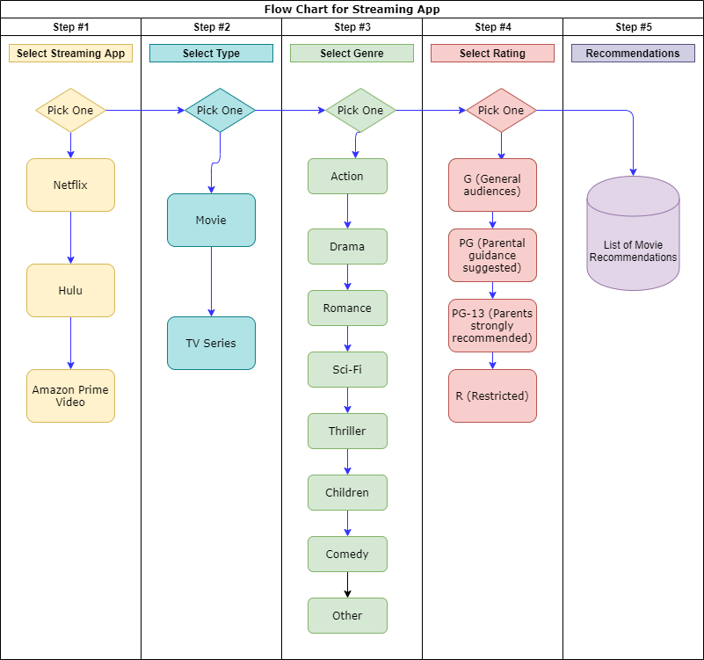
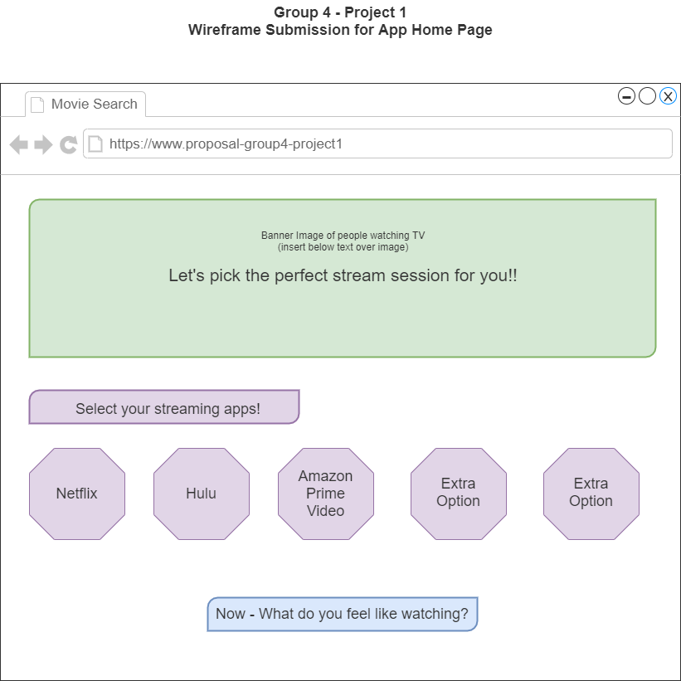
Beginning Development
Flowchart for App Logic
Wireframe

Slide 5
Project Requirements
Must use at least two server-side APIs
Must use a CSS framework other than Bootstrap
Use at least one new third-party API
Must have a polished, mobile-first UI
Must meet good quality coding standards (indentation, scoping, naming, etc.)
Does NOT use alerts, confirms, or prompts (look into modals).
Must be deployed to GitHub Pages
Must be interactive (i.e: accept and respond to user input)

Slide 6
Main Tools Used for Development
Languages
HTML
JavaScript
Standard CSS
Materialize CSS

Slide 7
Project APIs
Here are the two APIs that we used for this project.
IMDb API - https://rapidapi.com/apidojo/api/imdb8
This API was used to populate movies data based on user selection criteria because (in limited scenarios) this API had the data that showed where movies / TV series were streaming.
The Movie Database API - https://developers.themoviedb.org/3/getting-started/introduction
This API was used to populate the alternative list of movies current showing in theaters for when the application was unable to pull content matches for the users selections.

Slide 8
Lessons Learned
Remember what makes the project MVP
Stick to what is feasible to complete in the given timeframe
Prepare for API limitations
Start API research early
Make sure everyone knows how to use API documentation
Avoid API with quota limits if possible
Data accuracy is dependent on the data stored in the API

Slide 9
Demo!!
Here are the links to the team's GitHub Project Repo and GitHub pages link for our web application.
Link to GitHub Project Repo - https://github.com/Group4project1/project1
Link to GitHub Pages for Web App - https://group4project1.github.io/project1/

